Slide 1
Chapter 3 Hardware 3.2 output device

Slide 2
Objective
show understanding of the basic internal operation of the following specific types of device:
– * inkjet printer (喷墨打印机)
– * laser printer
– * 3D printer
– * speakers
– LCD monitor （液晶显示器）
– LED monitor （LED显示器）
– OLED monitor
– projector （投影仪）

Slide 3
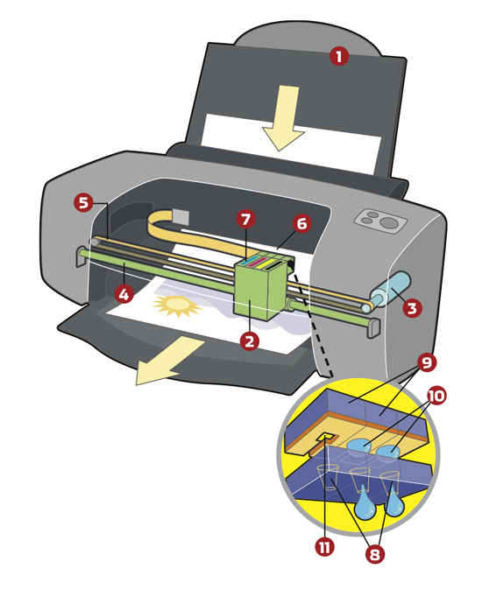
Inkjet printer
Process：
A paper is fed in
The print head moves across the sheet（纸张） depositing ink on to the paper
The paper is moved forward a fraction and the print head carries out another traversal until the sheet has been fully printed
Inkjet printer print the page line by line

Slide 4
The advantage and disadvantage of inkjet printer
Advantage
Disadvantage
Cheaper
Image quality can be excellent when used with photographic paper(相纸)
Expensive to run as they can use a lot of ink
Image quality can be poor when printing on ordinary(普通) paper
It is difficult to print on both sides of paper
They are slow at printing

Slide 5
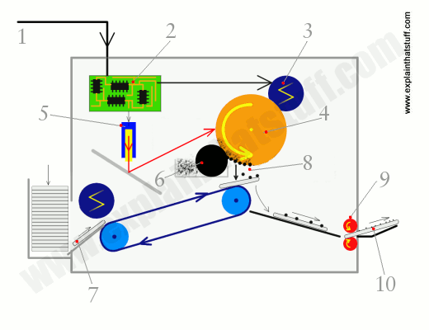
Laser printer
Principle:
The light reflects off the page onto a light-sensitive drum, it erases the positive charge and creates an area of negative charge instead.
The toner has been given a positive electrical charge, so it sticks to the parts of the photoreceptor drum that have a negative charge
A sheet of paper feeds up toward the drum, as it moves along, the paper is given a strong positive electrical charge
When the paper moves near the drum, its positive charge attracts the negatively charged toner particles away from the drum.
The heat and pressure from the rollers fuse the toner particles permanently into the fibers of the paper.

Slide 6
The advantage and disadvantage of laser printer
Advantage
Disadvantage
Cheap to run
Text printing quality is excellent
It is quick at printing
It is suitable for duplex printing, this reduces paper costs
It is expensive to buy
Image printing quality on photographic paper is not as good as inkjet printer

Slide 7
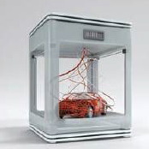
3D printer
3D design created in a suitable computer aided design(CAD) package
The design is split into layers
3D printer uses a nozzle(喷嘴) to squirt material on to the printed bed to create a physical layer to match the design
This process is repeated
The solid object is built up layer by layer
using materials such as powdered resin,
metal or paper.

Slide 8
The advantage and disadvantage of 3D printer
Advantage
Disadvantage
Bespoke items(定制产品) can be made quickly
Any shape can be printed
Design can be shared by sharing the digital file
Expensive
It is not durable(耐用)
Dangerous items may be printed
Slow

Slide 9
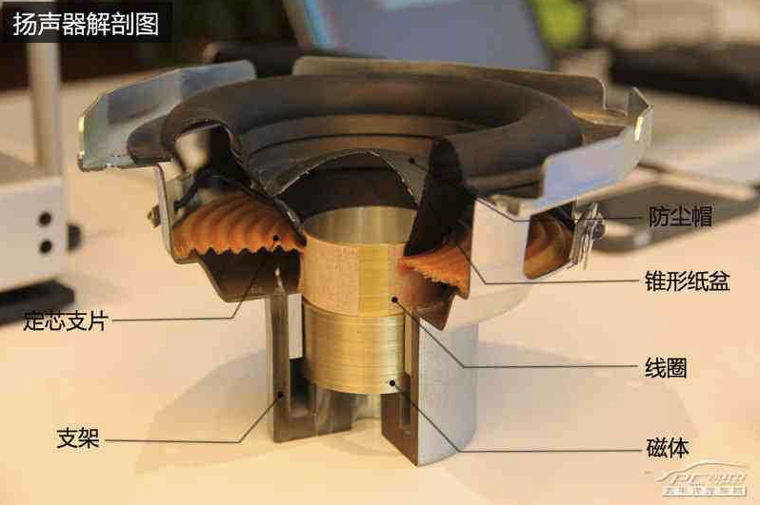
Loudspeakers

Slide 10
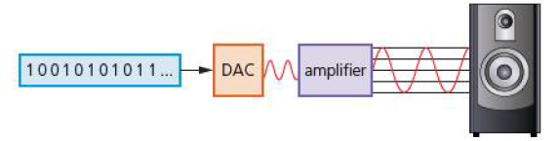
Loudspeakers
Sound is produced from a computer by passing the digital data through a digital to analogue converter (DAC) and then through an amplifier, finally the sound emerges from a loudspeaker.

